Slide 1

Raspberry Pi 3 - PWM
Husnu Melih Erdogan

Slide 2
PWM
Modulation with the width of an impulse.
It is used in telecommunication, audio equipment, lights, dc motors, servo motors, etc.
PMW operates like a switch constantly cycle on and off, so we can control the amount of the power our device get.
Motor takes time to respond to the voltage change, so we take an advantage of duty cycle.

Slide 3
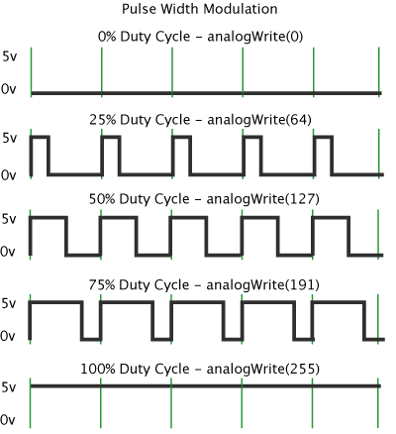
Duty Cycle
Percentage of on time is called duty cycle.
Duty Cycle =Turn ON time/ (Turn ON time + Turn OFF time)
Duty Cycle = (0.5/ (0.5+0.5)) = 50%
So the average output voltage will be 50% of the input voltage voltage.

Slide 4
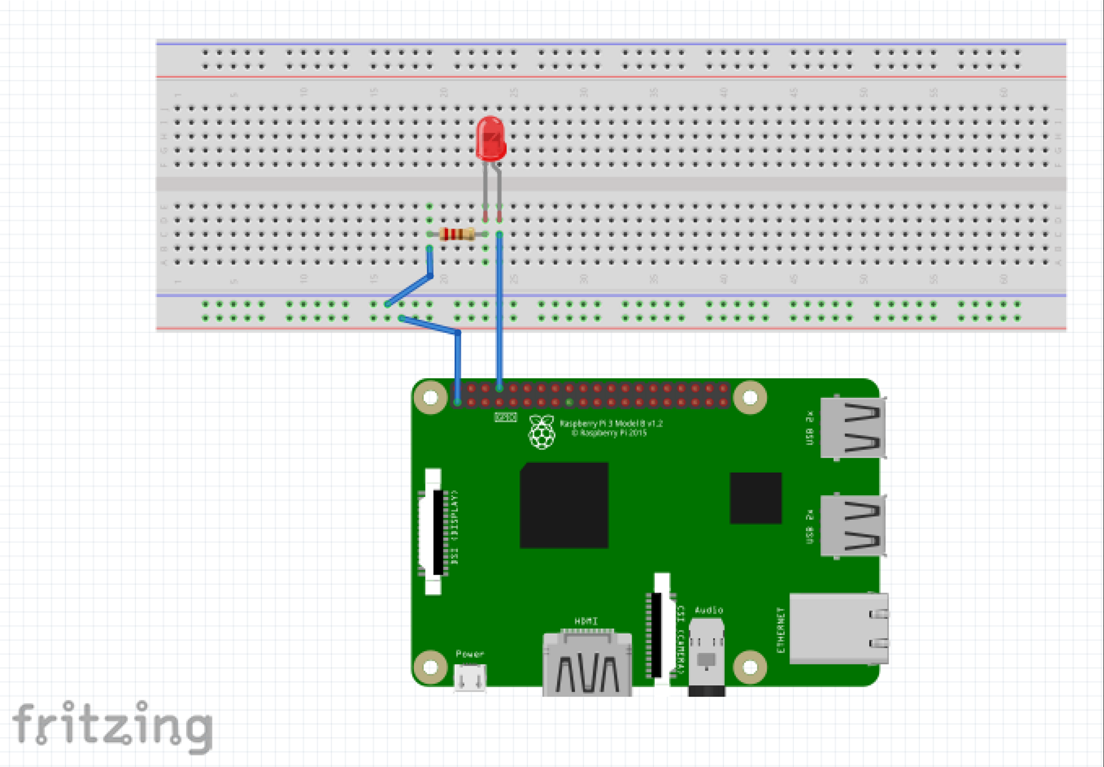
Control Brightness of LED - Circuit Design – Demo 1

Slide 5
Raspberry Pi
https://pythonhosted.org/RPIO/pwm_py.html
import RPi.GPIO as IO
import time
IO.setwarnings(False)
IO.setmode (IO.BCM) #we are programming the GPIO by BCM pin numbers. (PIN35 as ‘GPIO19’)
IO.setup(19,IO.OUT) # initialize GPIO19 as an output.
p = IO.PWM(19,100) #GPIO19 as PWM output, with 100Hz frequency p.start(0) #generate PWM signal with 0% duty cycle
while 1: #execute loop forever
for x in range (50): #execute loop for 50 times, x being incremented from 0 to 49. p.ChangeDutyCycle(x) #change duty cycle for varying the brightness of LED. time.sleep(0.1) #sleep for 100m second for x in range (50): #execute loop for 50 times, x being incremented from 0 to 49. p.ChangeDutyCycle(50-x) #change duty cycle for changing the brightness of LED. time.sleep(0.1) #sleep for 100m second
http://circuitdigest.com/microcontroller-projects/raspberry-pi-pwm-tutorial

Slide 6
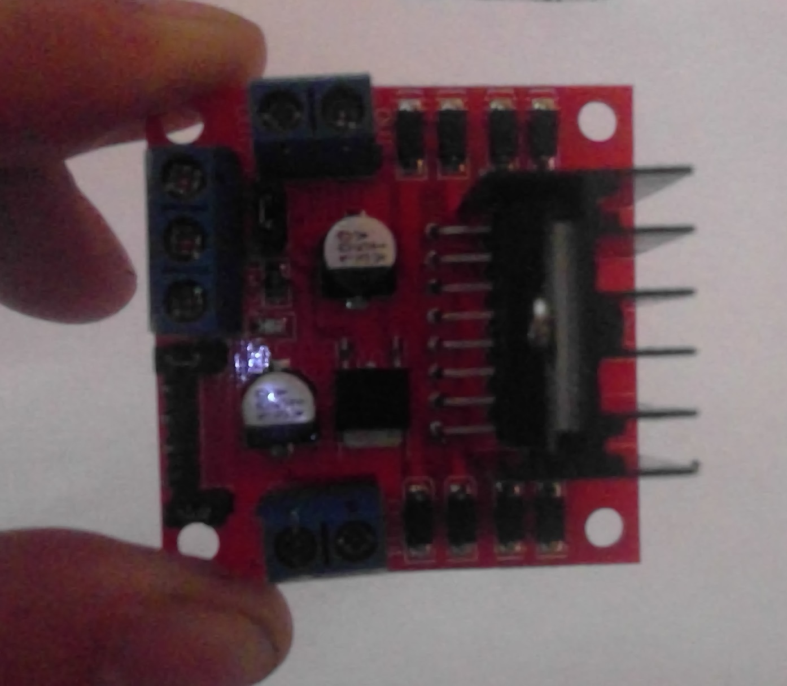
DC Motor Driver
Output Port - Motor 1
Voltage Input
GND
5V Output
PWM - Enable Motor 1
Motor 1 Rotation Pin 1
Motor 1Rotation Pin 0
Motor 2 Rotation Pin 1
Motor 2 Rotation Pin 1
PWM - Enable Motor 2
Output Port - Motor 2

Slide 7
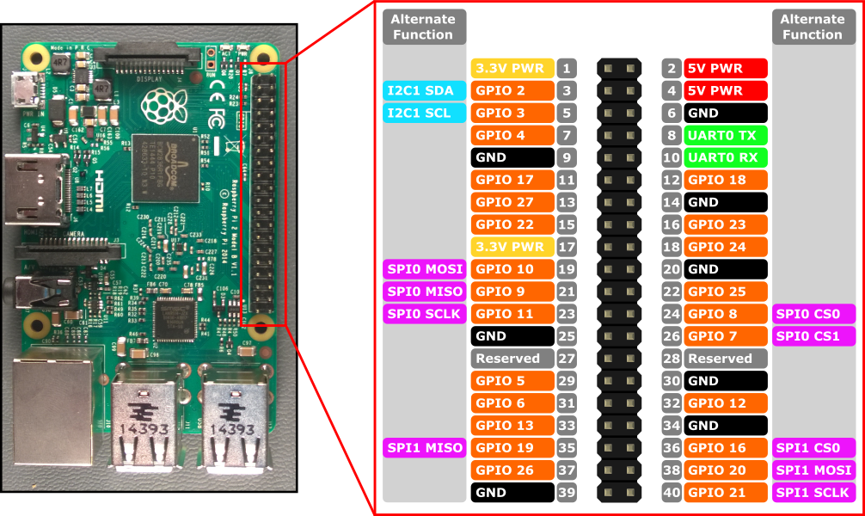
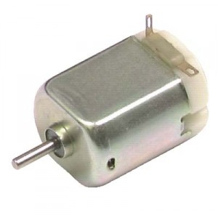
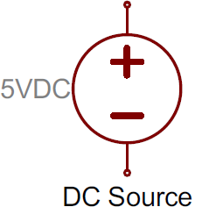
DC Motor Driver Circuit

